Slide 1
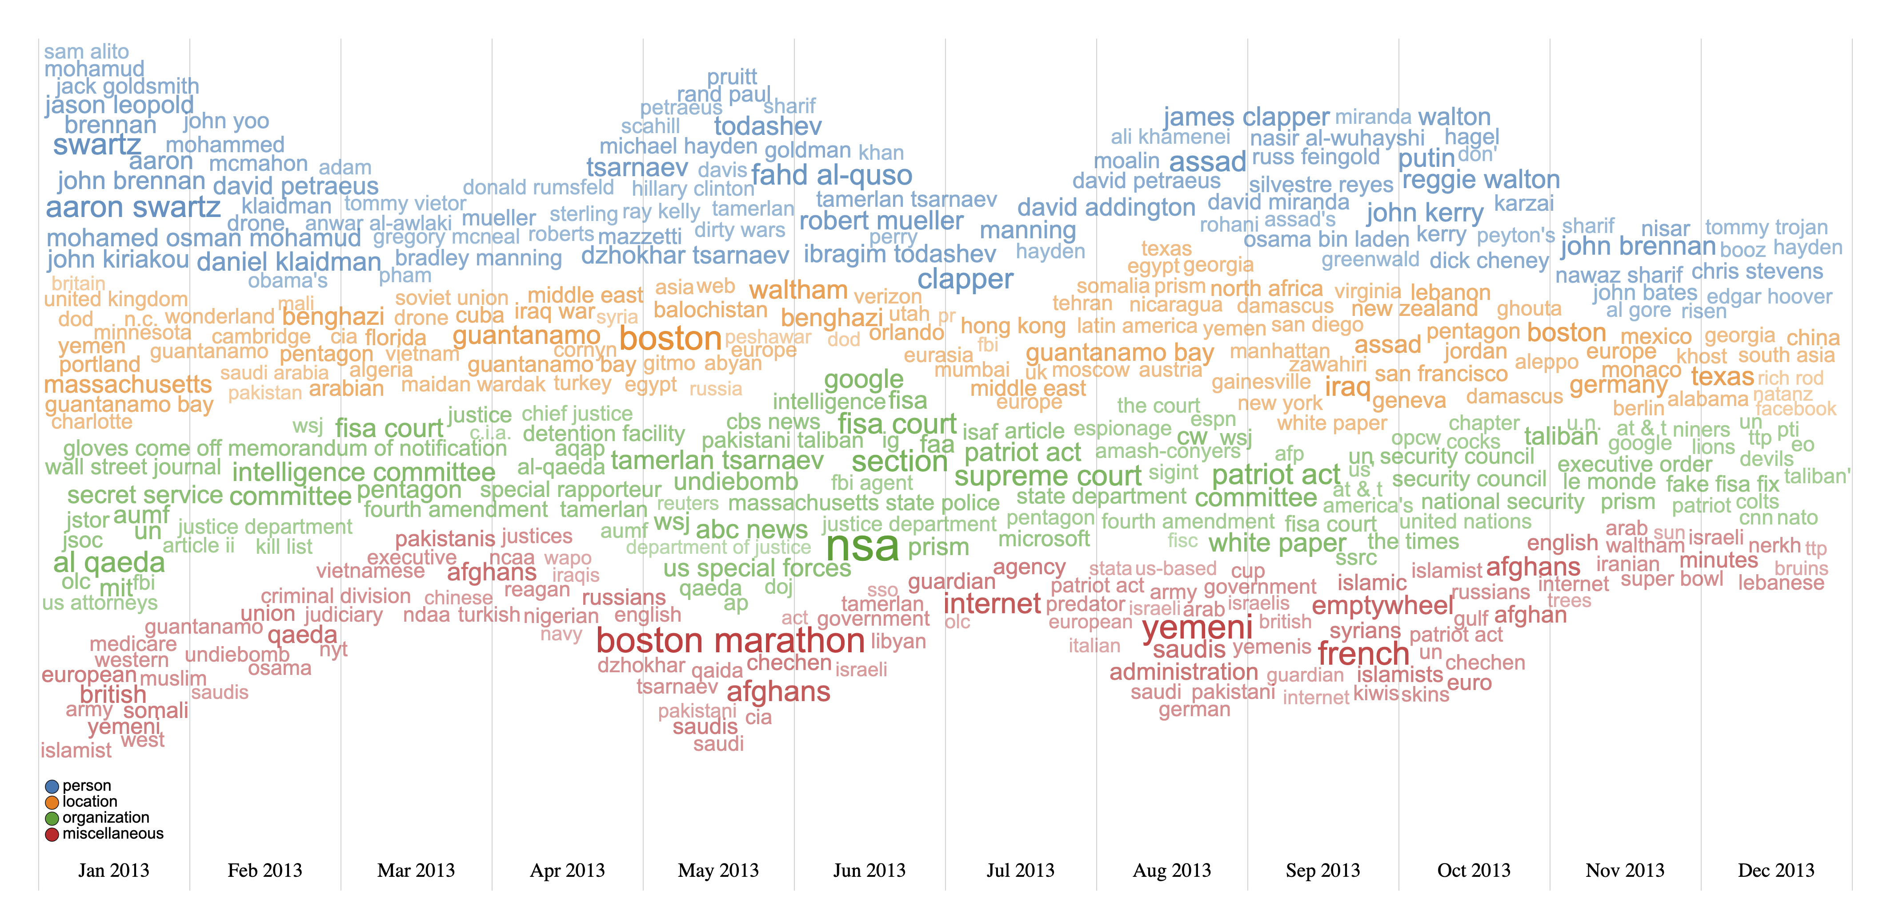
Empty Wheel Blog
https://www.emptywheel.net/
Maximum 15 words/box
Compactness: 0.88
336 unique words

Slide 2
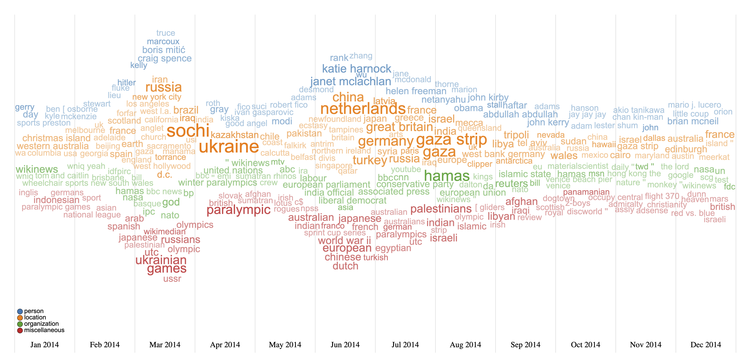
WikiNews
https://en.wikinews.org/wiki/Main_Page
Maximum 20 words/box
Compactness: 0.87
254 unique words

Slide 3
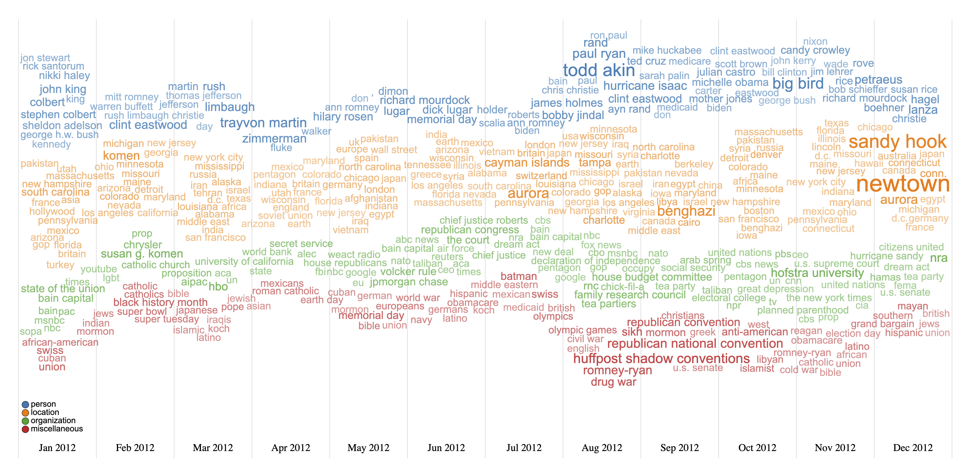
Huffington Post
https://www.huffpost.com/
Maximum 15 words/box
Compactness: 0.79
302 unique words

Slide 4
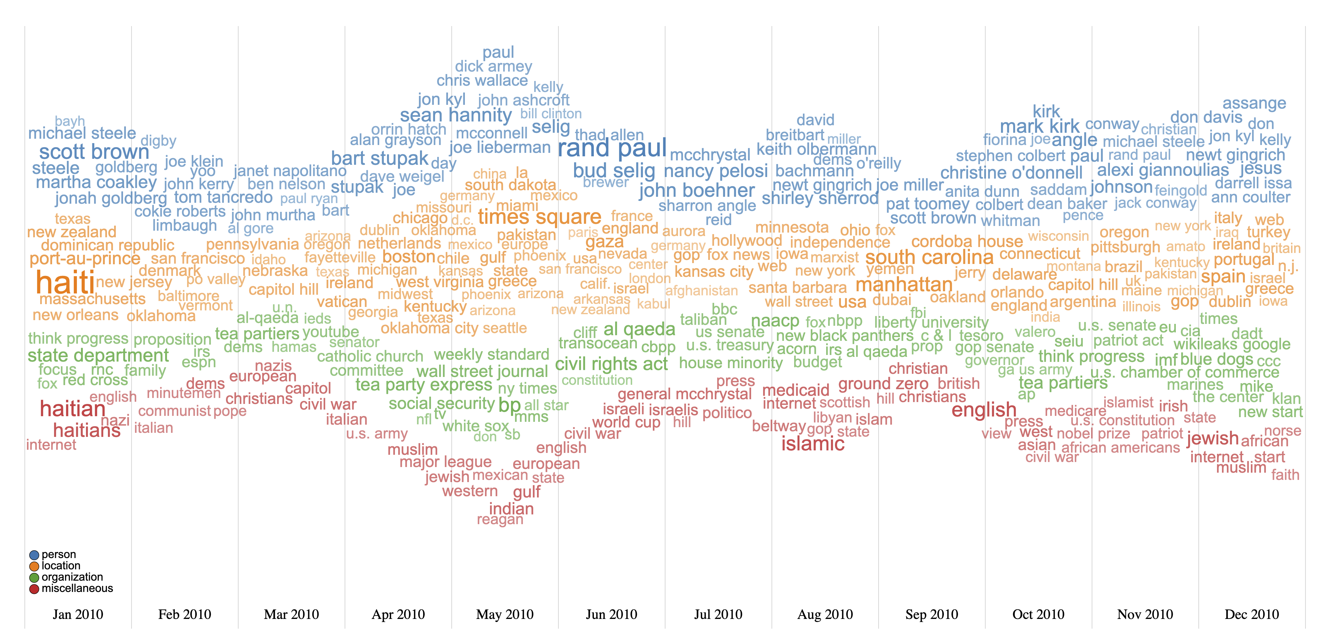
Crooks and Liars
https://crooksandliars.com/
Maximum 15 words/box
Compactness: 0.87
320 unique words

Slide 5
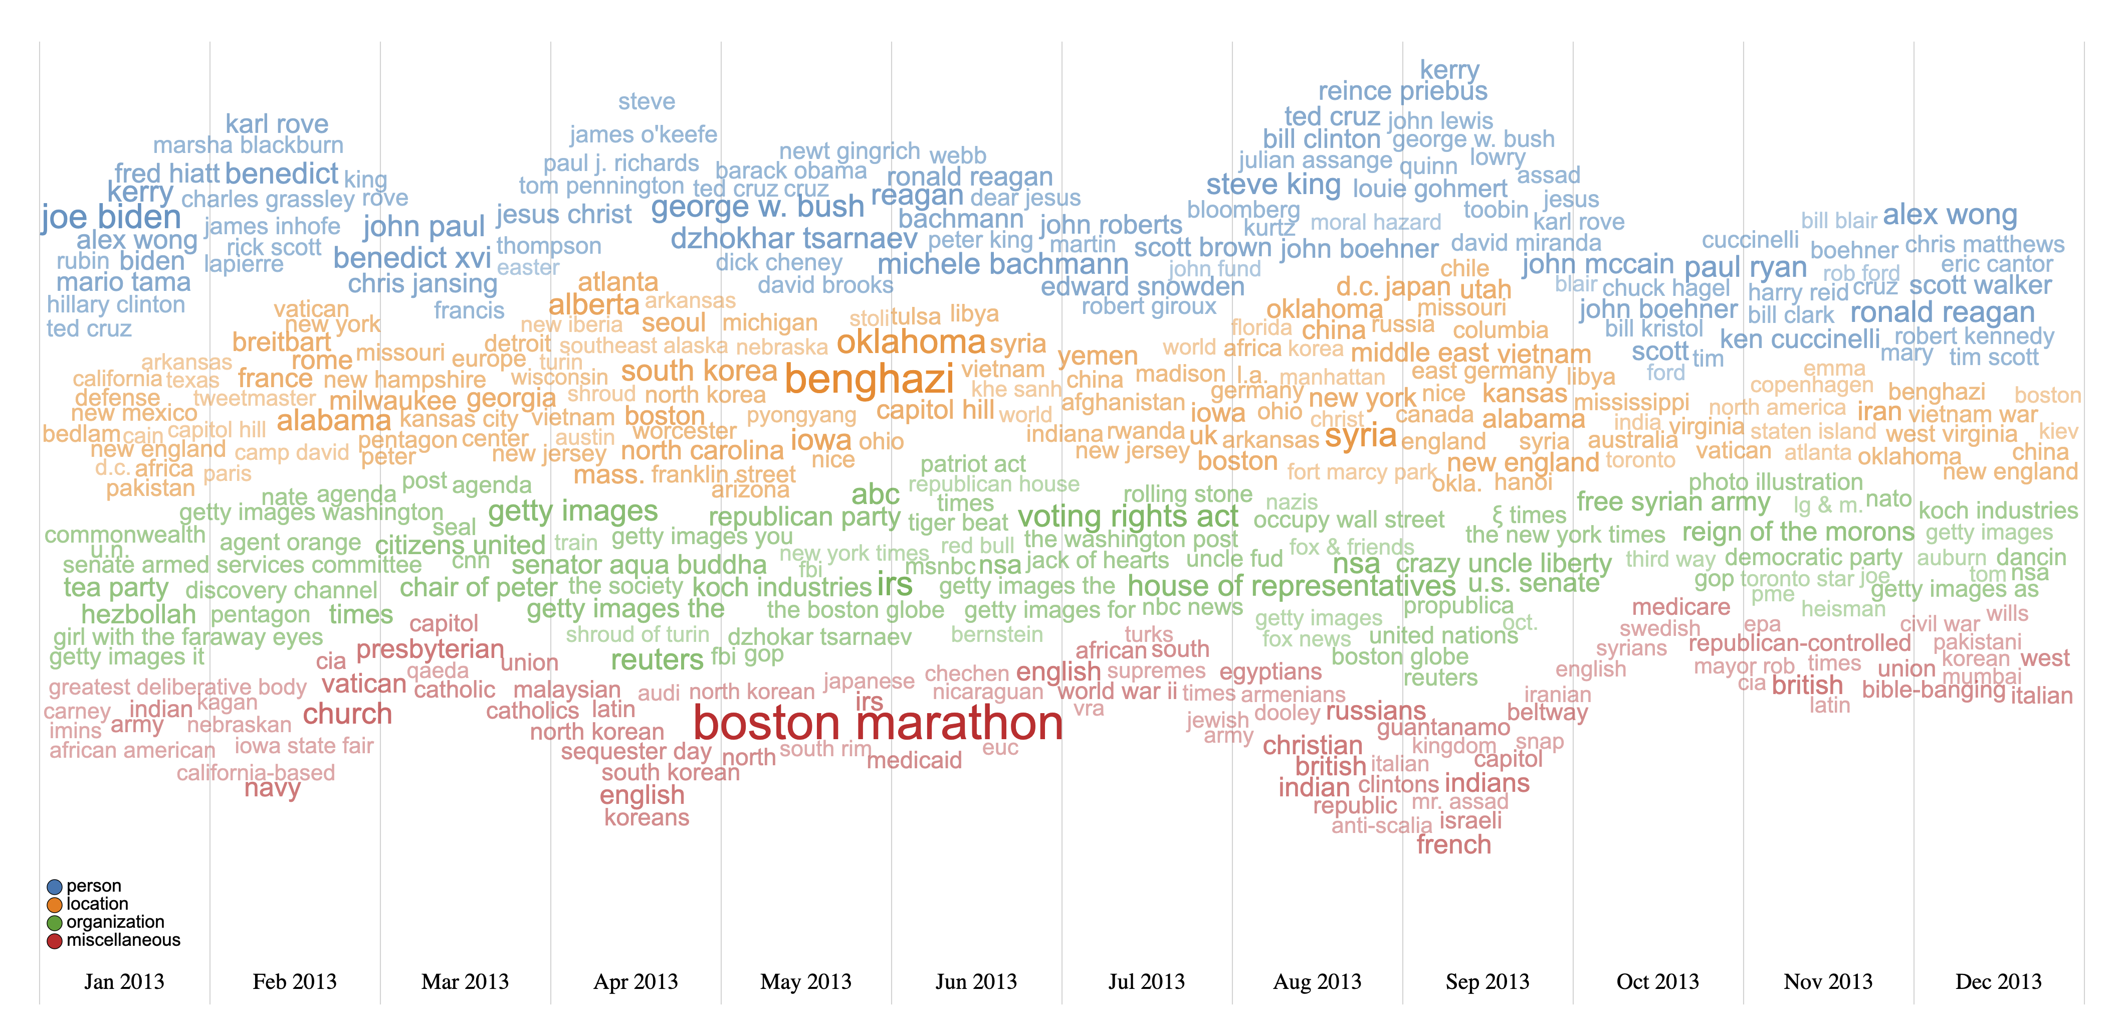
Esquire
https://www.esquire.com
Maximum 15 words/box
Compactness: 0.86
344 unique words

Slide 6
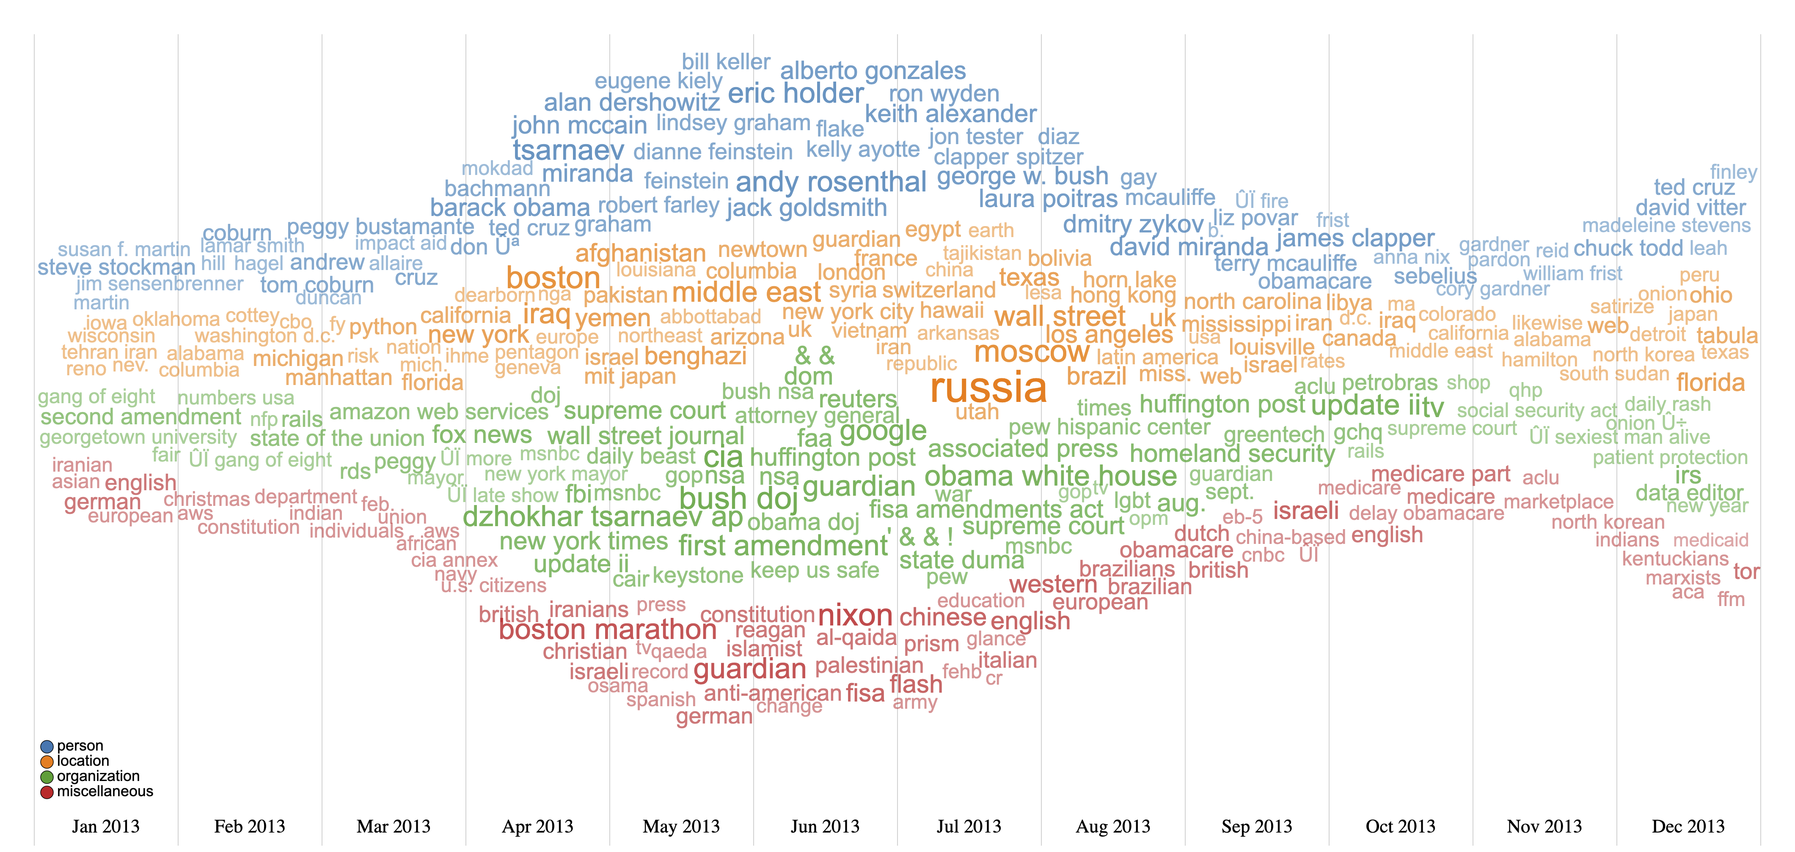
FactCheck
https://www.factcheck.org/
Maximum 15 words/box
Compactness: 0.88
297 unique words

Slide 7
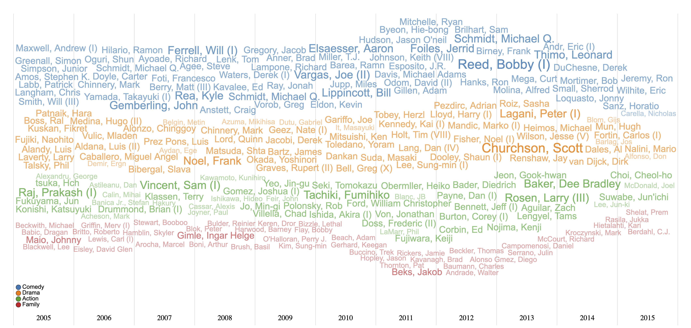
IMDb co-star database
https://www.imdb.com/interfaces/
Maximum 15 words/box
Compactness: 0.80
222 unique words

Slide 8
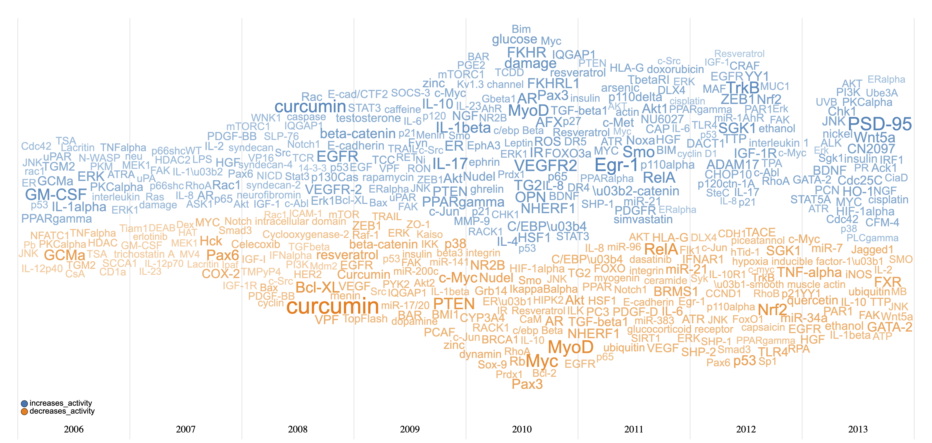
Fries Cards database
https://github.com/clulab/reach/wiki/Datasets
Maximum 35 words/box
Compactness: 0.87
321 unique words

Slide 9
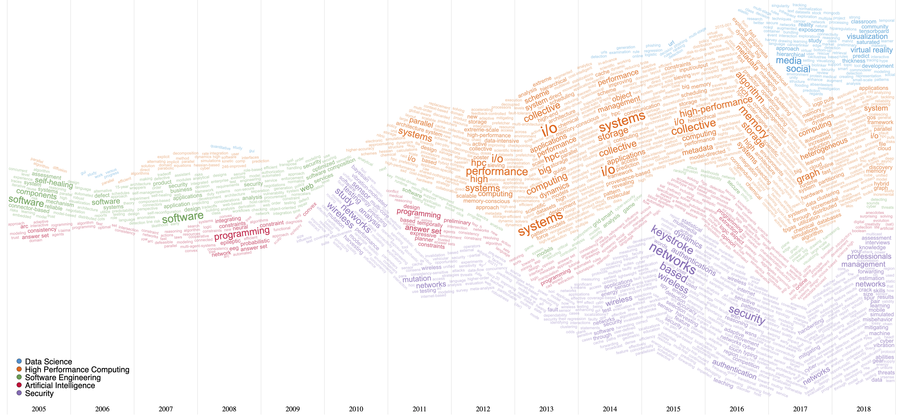
Research Evolution – Computer Science Department, Texas Tech University
Time span: 1995 - 2016
Maximum 100 words/box
Compactness: 0.80
986 unique words

Slide 10
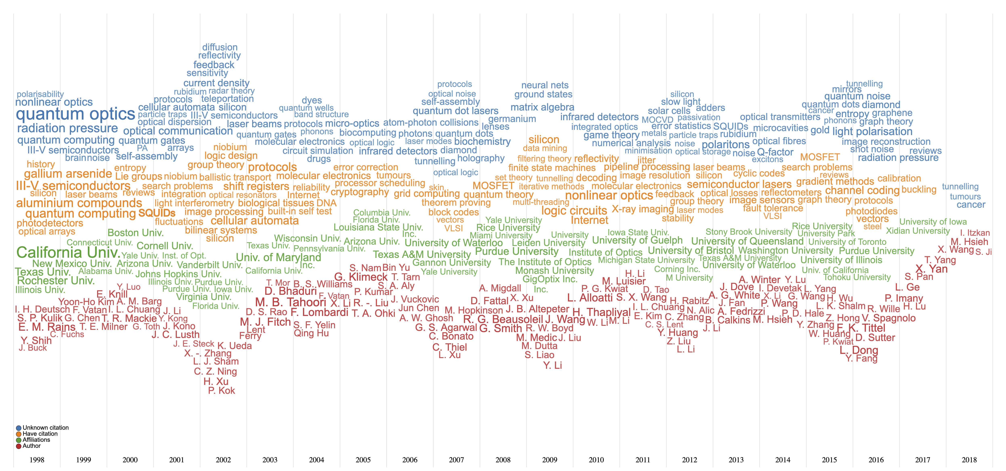
Quantum Computing Publications
Time span: 1998 - 2018
Maximum 25 words/box
Compactness: 0.81
300 unique words

Slide 11
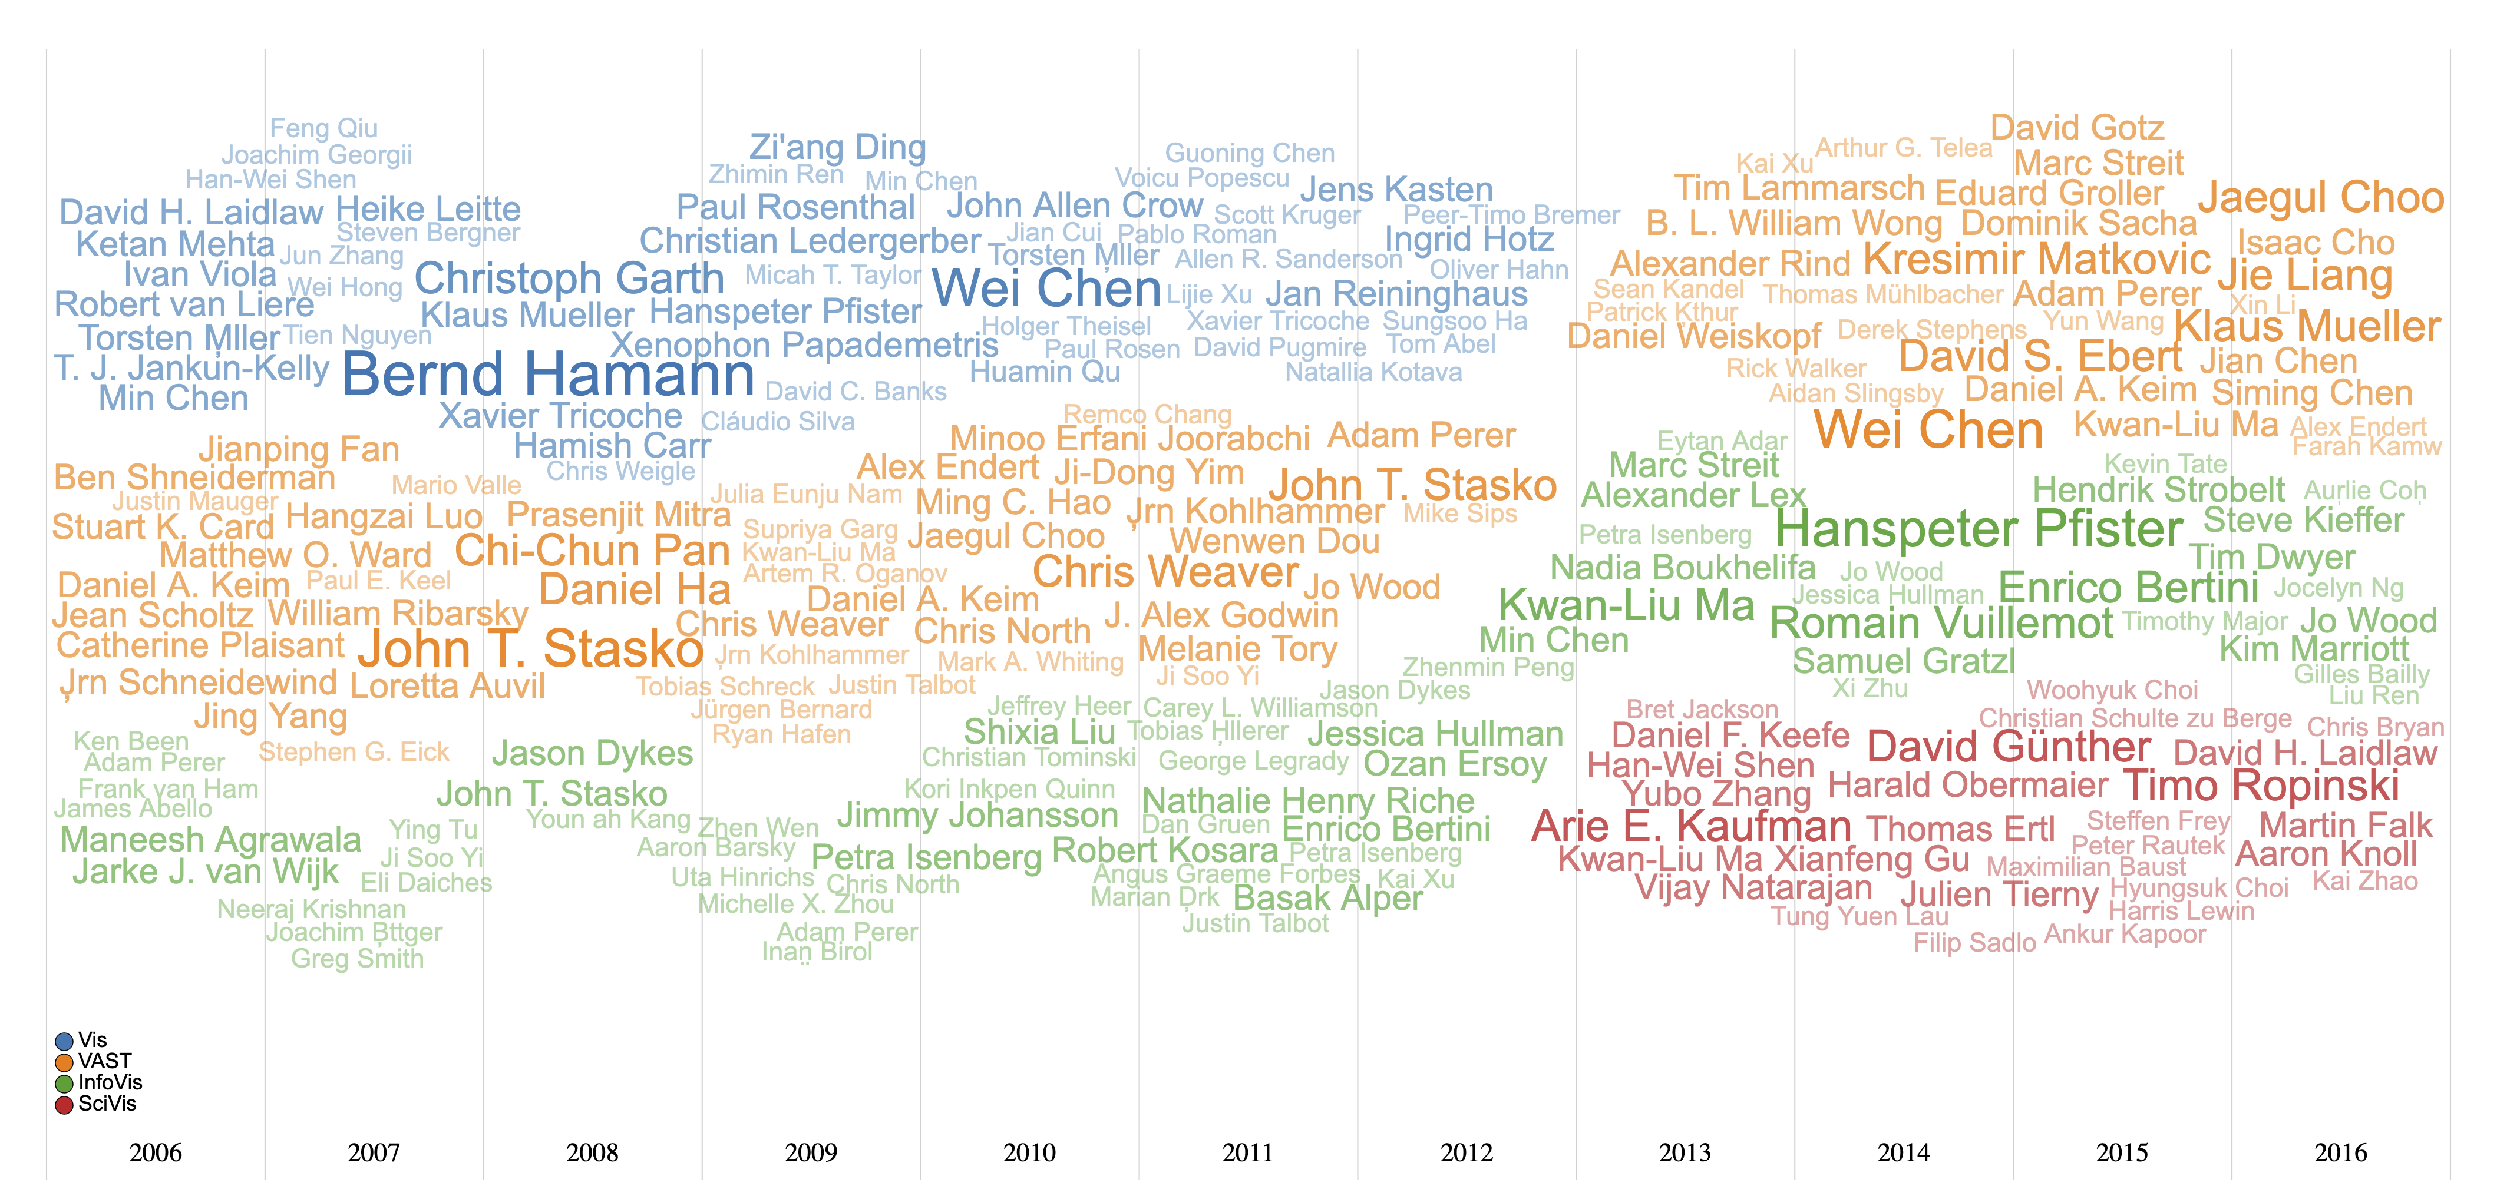
Visualization Publications
Time span: 1995 - 2016
Maximum 15 words/box
Compactness: 0.84
207 unique words

